Slide 1
How Far Can You See Into The Future?

Slide 2
I Am Talking About The City’s Financial Managing Capability

Slide 3
Your Managing Capability Probably Ends With The Operating Budget Ending June 30

Slide 4
Until You Start The Next Budget Process, You Can’t See Beyond The Budget Year

Slide 5
It Is Really Difficult To See A Future When There Is No Documentation

Slide 6
Wouldn’t It Be Fantastic To Consider/Plan/Prioritize Any Future Large Expenditures For 5 Or 6 Years

Slide 7
What Do You Need To See Into The Future?

Slide 9
What If You Created A List Of Proposed Large Expenditures By Department?

Slide 10
Right Now, Department Heads That Are Better Communicators Get Projects Funded

Slide 11
All Future Capital Expenditures Could Be Delineated Along Fiscal Years

Slide 12
All Expenditures Shoud Be Prioritized

Slide 13
Revenues For All Projects Should Be Identified
Grants
Debt
Donations
Fund Balance

Slide 14
The Governing Body Should Approve Of The List Without Any Additional Spending Authorization

Slide 15
What Do You Need?

Slide 17
You Need A Capital Improvement Program
A Capital Improvement Program, Also Called A Capital Budget Or Capital Plan, Is A Spending Plan For Improvements To Or Acquisition Of Land, Facilities, And Infrastructure.
It Can Also Include Plans For Purchasing Other Assets.

Slide 18
The Capital Improvement Program (CIP) Is Typically Approved By The Governing Body
Governing body approval does NOT obligate the city to do anything.
It is truly a plan for the future.

Slide 19
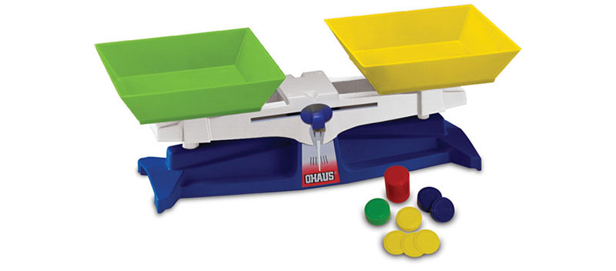
A CIP Balances Revenues And Expenditures, Identifies The Sources Of Revenues, And Lists Each Project Separately

Slide 20
The CIP Is A Subset Of The Adopted Annual Operating Budget

Slide 21
All Department Heads Could Contribute Their Own Departmental Proposals Along With Any Anticipated Revenues Or Grant Sources

Slide 22
Budget Rule
A municipality can have an operating budget without a capital improvement budget,
But it cannot have a capital improvement budget without an operating budget.

Slide 23
The Capital Budget Portion Of The Annual Operating Budgets Also Mark The First Year Of A Capital Improvement Program (CIP) Or Multi-year Budget, Which Typically Spans Five Years

Slide 24
You Should Establish A Minimum Dollar Threshold For An Acquisition To Be Considered In The CIP. This Might Agree With Your Capitalization Threshold

Slide 25
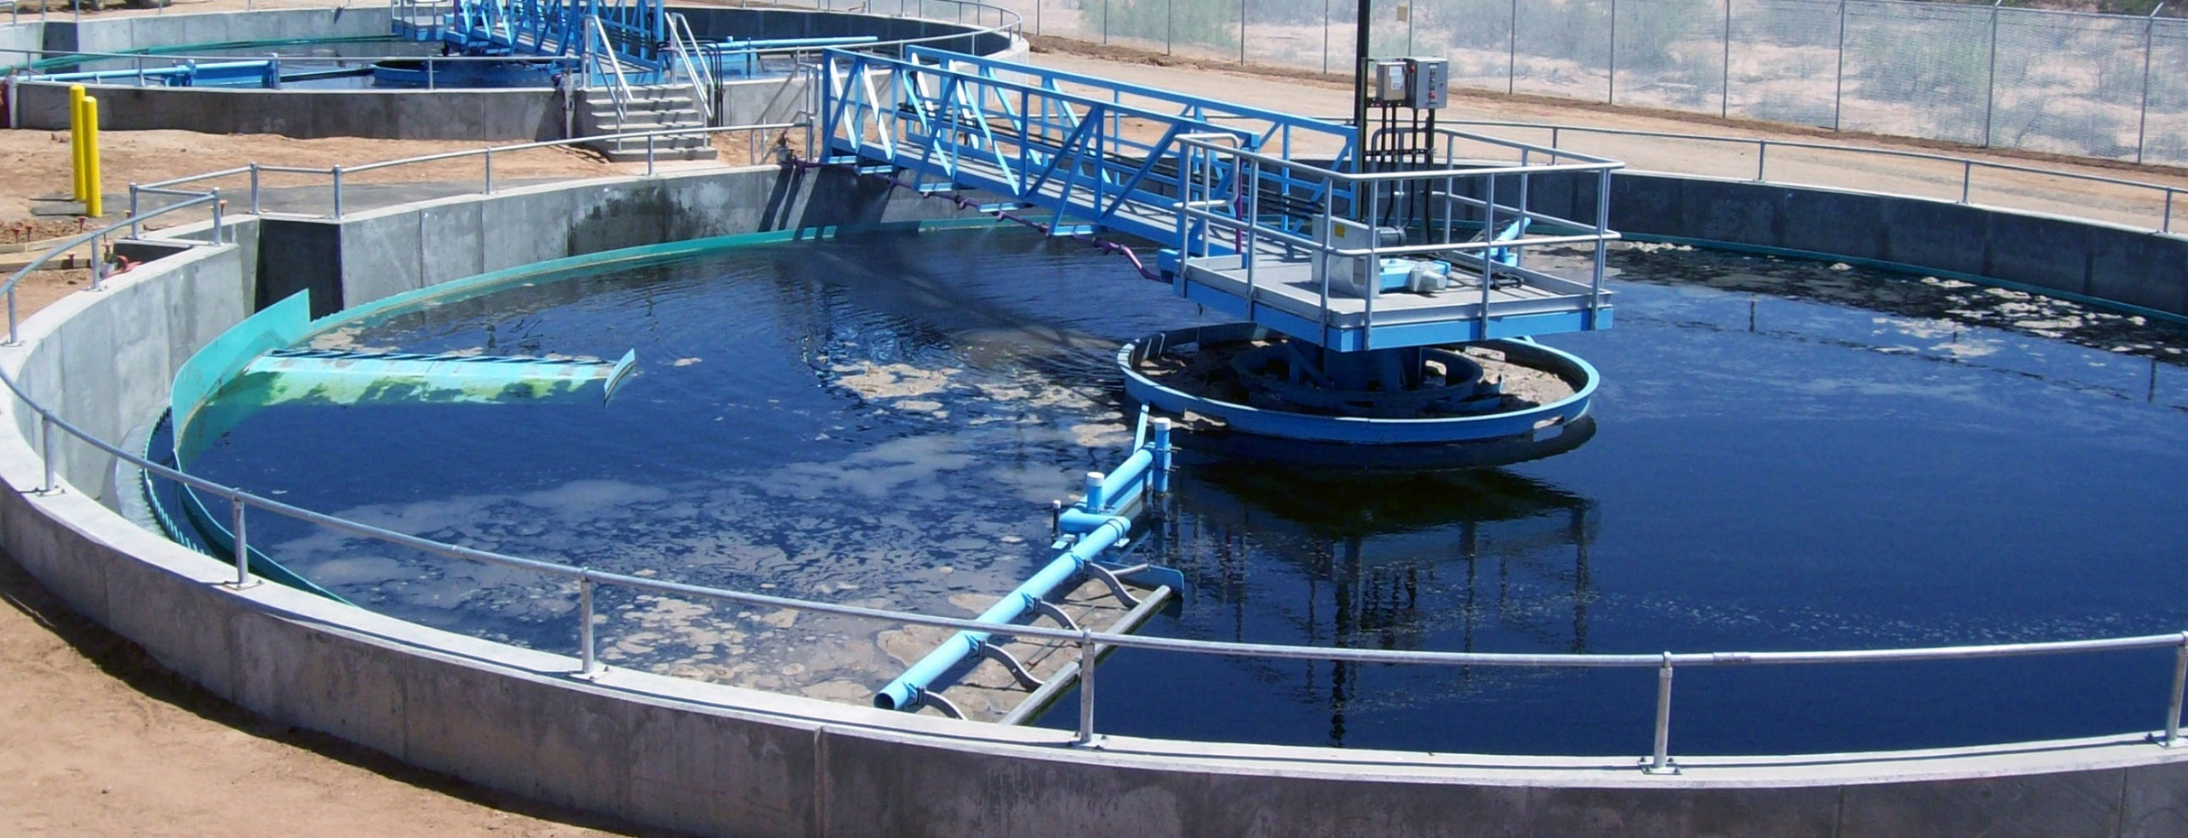
Capital Improvement Projects Typically Last For More Than One Fiscal Year

Slide 26
The CIP Needs To Be Updated Every Year To Review Expected Revenues, Inflation, Project Length, Project Necessity, Project Prioritization, And Status Of On-going Projects

Slide 27
Another State Law Requires…
Even If A Formal CIP Is Not Prepared, A Statement Showing Pending And New Capital Projects Along With How The Projects Will Be Funded Must Be Included In The Budget Ordinance.

Slide 28
Will The Capital Acquisition Have A Financial Operating Impact?
A CIP includes how a project will affect the operating budget regarding increased revenues or expenditures.
Many capital projects will require additional expenditures for operations after the project is complete.
It is also possible that a capital project will save on future operating costs.

Slide 29
What Are The Advantages Of A CIP?
You and the governing body can see and plan the future.

Slide 30
What Are The Advantages Of A CIP?
It forces consideration of life expectancies of facilities and equipment.
How long will it be in service?

Slide 31
What Are The Advantages Of A CIP?
It helps set priorities.
Some things need to happen before another can start.
There is never enough money to fund a wish list.

Slide 32
What Are The Advantages Of A CIP?
It allows multi-year financing for projects that might otherwise not be attempted without debt issuance.

Slide 33
What Are The Advantages Of A CIP?
It helps create an orderly process.
Except for emergencies, future purchases are planned and prioritized.

Slide 34
What Are The Advantages Of A CIP?
The CIP document becomes a roadmap for newly elected officials.

Slide 36
What Are The First Steps?

Slide 37
The First Step In Developing A CIP Is…

Slide 38
What Are The First Steps?
The first step in developing a CIP is to start planning. This includes setting a calendar.

Slide 39
Create An Inventory Of Equipment, Buildings, And Facilities
You should have a minimum dollar threshold to be considered in the CIP.
This may agree with your capitalization threshold.
List all currently owned assets the will be replaced.

Slide 40
What Are The First Steps?
Assess the status of current large projects, including funding and targeted completion dates.

Slide 41
Assess The Status Of Current Large Projects Including Funding And Completion Dates
All eligible projects must be tracked on the CIP.
A Key to accuracy is consistently tracking all expenditures for each project. The recording of expenditures is usually done monthly.
Targeted Completion Dates should be monitored and updated as needed.

Slide 42
I Hate It When Finance Asks Me About Spending Over The Next Five Years. It’s Not Like I Have 2020 Vision

Slide 43
Identifying Future Needs
Each budgeted department should be planning for its future capital needs including replacement of their existing assets.
Determine how much will be spent on the proposed capital replacement.
The department head should have the best cost estimate for their proposed purchase.

Slide 44
What Are The First Steps?
Some items need to be culled from a wish list to create a CIP.
Prioritize the items selected for the CIP.
Some things need to come before another.

Slide 45
What Are The First Steps?
All departments need to be involved in this process. Their input and support is valuable.
Even in a small town, it would be difficult for the city recorder to prepare a CIP by themselves.
It makes sense to use department heads to complete their departmental priorities and proposed capital purchases.

Slide 46
What Are The First Steps?
Department heads are more likely to know about any available grants or low interest loan programs.
Also, you want the support of all departments with citizens and council members in the on-going CIP process.
You cannot have city employees railing against the CIP.

Slide 47
What Is Next?
The next step is to look at finances.
Assess and establish your financing options (Can we pay for this in cash if we set aside $10,000 each year for five years? Is a lease/purchase a better option?
What about issuing a bond?
Determine your financial limits.
Determine your current debt obligations.

Slide 48
What Is The Final Step?
The last step of the capital budgeting process is its implementation.
The CIP is normally approved by resolution.
No spending is authorized by this resolution.
The first year of the CIP should be adopted as a section in the annual operating budget wherein spending is authorized.

Slide 49
What is the Role of Fund Balance?
In governmental funds, fund balance is the difference between assets and deferred outflows less liabilities and deferred inflows.
It is divided into five classifications.

Slide 50
Unassigned Fund Balance
The unassigned amounts represent those funds which are left for spending after funds earmarked for specified purposes have been otherwise classified.
Unassigned fund balance can be a budget lifesaver. It can make up for a temporary reduction in revenues. It is used for any emergency or unplanned expenditure.

Slide 51
Now That You Have A CIP
The CIP is not a static document.
IT IS ALIVE.
The CIP’s credibility comes from:
Its support from staff and council members
Following the priorities established in the CIP
Purchasing as planned in the CIP, except for emergencies

Slide 52
Now That You Have A CIP
A CIP can add significant stability to your future capital spending.
Spending may be planned and prioritized.
A CIP can last beyond any individual elected official.
Multiple capital projects could be financed with a single debt – lowering borrowing costs.
All can SEE planned future projects.

