Slide 1
It’s Your Deal: Roles and Responsibilities in a Municipal Issuance
October 13, 2017 | TGFOA Fall Conference

Slide 2
Priya Ghosh Ahola, Outreach Manager
Municipal Securities Rulemaking Board

Slide 3
It’s YOUR Deal

Slide 4
Topics
Working with Municipal Finance Professionals
Understanding Continuing Disclosure Obligations
Using EMMA® Tools for Issuers
Accessing Market Education

Slide 5
Role of the MSRB

Slide 6
Mission of the MSRB
Promote a fair,
transparent and
efficient municipal market
Protect investors, issuers and the public interest

Slide 7
MSRB Protections for Issuers
MSRB Rules
For municipal securities dealers and municipal advisors
Not for issuers
EMMA®
Municipal bond disclosure documents
Trade data
Education Center
Objective, multimedia educational resources about municipal market
Regulation
Transparency
Education

Slide 8
Working with Municipal Finance Professionals

Slide 9
The Deal Team
Municipal Advisor(s)
Deal Table
Underwriter(s)
Underwriting Syndicate Member
Selling Group Members
Other Counsel
Issuer
Underwriter’s Counsel
Feasibility Consultant
Auditor
Trustee
Bond Counsel
Credit Enhancer
Rating Agencies
Disclosure Counsel
MSRB-Regulated
MSRB-Protected

Slide 10
Role of the Underwriter
Designing the plan of finance
Developing the bond structure
Providing proceeds at closing
Determining timing of sale
Executing pre-sale marketing
Managing bond pricing
Developing bond documents

Slide 11
Duties of the Underwriter
Has an “arm’s-length” relationship with issuers
Duty of fair dealing
Duty of fair pricing
Must respect priority provisions and retail order periods
Provides official statement to investors
Fair Dealing
MSRB Rule G-17
Among other provisions, requires underwriters to disclose role, compensation and actual or potential material conflicts of interest to issuer

Slide 12
Role of the Municipal Advisor
Developing requests for proposals
Assisting in selection of underwriters
Analyzing financing alternatives
Advising on the method of sale
Developing the plan of finance

Slide 13
Duties of the Municipal Advisor
Has a fiduciary duty to municipal entity clients
Duty of care and duty of loyalty
Must put municipal entity client’s interests of ahead of its own
Has a duty of care to obligated person clients
Standards of Conduct
MSRB Rule G-42
Sets forth core elements of the fiduciary duty and provides guidance on certain conduct and issues likely to occur in the course of engaging in municipal advisory activities

Slide 14
What to Expect from Your Municipal Advisor
Check
Verify firm registration
Check professional qualification
Know
Understand what professionals can and can’t do under MSRB rules
Report
Contact the MSRB to report potential rule violations

Slide 15
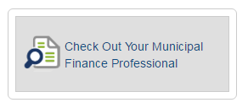
Verify Municipal Advisor Registration
All municipal advisor firms should be registered with both the SEC and the MSRB
Find a full list of MSRB-registered firms on the MSRB website
http://www.msrb.org

Slide 16
Look for Series 50 Qualification
MSRB requires all municipal advisors to take and pass the professional qualification exam
After September 12, 2017, individuals cannot engage in municipal advisory business if they have not passed the MSRB’s Series 50 exam
View a list of Series 50-qualified municipal advisor professionals on the MSRB’s website http://msrb.org/MARegistrants.aspx

Slide 17
Check Professional Qualifications
Individuals cannot engage in municipal advisory business if they have not passed the MSRB’s professional qualification exam (Series 50)
View a list of Series 50-qualified municipal advisor professionals on the MSRB’s website
http://msrb.org/MARegistrants.aspx

Slide 18
Municipal Advisors MUST
Put municipal entity client’s interests ahead of their own
Disclose conflicts of interest
Provide documentation of municipal advisory relationship
Make suitable recommendations
Know their clients

Slide 19
Municipal Advisors MUST NOT
Charge excessive compensation and fees
Deliver inaccurate invoices for fees or expenses
Make false or misleading representations about their capacity or knowledge
Advise on certain transactions where the municipal advisor’s firm is acting as principal
Attempt “pay-to-play” activities
Attempt to give excessive gifts or gratuities to an employee of an issuer client

Slide 20
Report a Complaint
Submit complaints to the MSRB
202-838-1330
complaints@msrb.org
Submit complaints to the SEC
U.S. Securities and Exchange Commission Office of Municipal Securities 100 F Street, NE Washington, DC 20549
Tips, Complaints and Referrals Portal
Submit complaints about FINRA-registered municipal advisors to FINRA
FINRA's Investor Complaint Center

Slide 21
Muni Market Facts

Slide 22
Pop Quiz
What’s the average number of daily trades in municipal bonds?
35,000
Which state issues the largest par amount for infrastructure financing?
California
How many municipal bonds are outstanding?
1 million
In contrast, there are about 30,000 corporate bonds outstanding.

Slide 23
Understanding Continuing Disclosure Obligations

Slide 24
Importance of Disclosure
Timely and complete disclosure by issuers of municipal securities is essential to:
Building investor confidence in the municipal market
Sustainable access to capital for state and local governments
Maintaining public trust and accountability to taxpayers
The integrity of the municipal market

Slide 25
MSRB Principles for Disclosure
Fully own the official statement.
Make timely and complete continuing disclosures.
Voluntarily disclose information on bank loans and alternative financings.
Fully utilize the EMMA website as a resource.
Institute regular training for and make educational resources about the municipal market and its rules available to professionals at all levels of government.
http://www.msrb.org/Market-Topics/Disclosure.aspx

Slide 26
Required Disclosures (SEC Rule 15c2-12)
Financial/ Operational
Comprehensive Annual Financial Report
Event Notices
Notices of specific events that can have an impact on key features of the bonds
Audited Financial Statements
Financial Information
Operating Data
Notice of Failure to File Annual Financials
Must be submitted within 10 business days

Slide 27
Required Event Disclosures
Principal and interest payment delinquencies
Non-payment related defaults
Unscheduled draws on debt service reserves reflecting financial difficulties
Unscheduled draws on credit enhancements reflecting financial difficulties
Substitution of credit or liquidity providers, or their failure to perform
Adverse tax opinions or events affecting the tax-exempt status of the security
Modifications to rights of security holders
Bond calls and tender offers
Defeasances
Release, substitution or sale of property securing repayment of the securities
Rating changes
Bankruptcy, insolvency or receivership
Merger, acquisition or sale of all issuer assets
Appointment of successor trustee

Slide 28
Continuing Disclosure Agreements
Issuer’s contractual obligations for:
What to disclose in annual financials
Required timing of annual financials
Events that will trigger disclosure
History of compliance with SEC Rule 15c2-12
Often included as exhibits or appendices in official statements
Details and requirements can vary from issue to issue
Do you remember signing a CDA?

Slide 29
Anti-Fraud Regulations for Disclosure
Apply to both required and voluntary disclosures
Prohibit fraudulent, inaccurate or misleading information in disclosures to investors
Material information may not be omitted
Anti-Fraud Regulations
Securities Exchange Act of 1934
SEC Rule 10b-5

Slide 30
Consequences of Failure to Comply
Violations of anti-fraud laws may result in:
SEC charges against issuers
Fines
Bans from business
Any instance of failure to provide required continuing disclosures must be disclosed in the issuer’s subsequent official statements
Five-year requirement after failure
Applies even after failure has been rectified
SEC’s MCDC Initiative
71 issuers in 45 states cited for offering documents containing materially false statements or omissions

Slide 31
Submitting Required Disclosures to EMMA

Slide 32
Bank Loan Disclosure
MSRB advocates and facilitates voluntary disclosure of bank loans and alternative financings
Provides investors with full picture of municipal entity’s indebtedness
Enhances market transparency
SEC recently proposed changes to require disclosure of financial obligations such as bank loans

Slide 33
Submitting Bank Loan Disclosures
New!

Slide 34
Using EMMA® Tools for Issuers

Slide 35
What’s on EMMA
Disclosures
Data
Official Statements
Advance Refunding Documents
Event Notices
Financial Disclosures
529 Plan Disclosures
Municipal Asset-Backed Securities Disclosure
Political Contribution Disclosures
Trade Prices and Yields
Interest Rate Resets for Municipal Variable Rate Securities
Credit Enhancement Documents for Variable Rate Securities
Credit Ratings
New Issuance Statistics
Trade Statistics
Disclosure Statistics

Slide 36
EMMA Tools and Resources

Slide 37
Organization Account
Creates single continuing disclosure submission account for all agents and staff of an issuer
Allows master account administrator to securely and independently manage staff access
Required to customize and manage issuer homepages and other EMMA® tools for issuers

Slide 38
Organization Account Checklist
Existing individual disclosure submission account information, if applicable
Organization name and contact information
Contact information for a master account administrator
Federal Tax Employer Identification Number (EIN)
EIN documentation (letterhead, official statement)

Slide 39
Email Reminders
Issuers can schedule automated emails from EMMA® to be reminded of approaching annual or quarterly financial disclosure filing deadlines
Include additional contacts to ensure all those with a role in disclosure are alerted

Slide 40
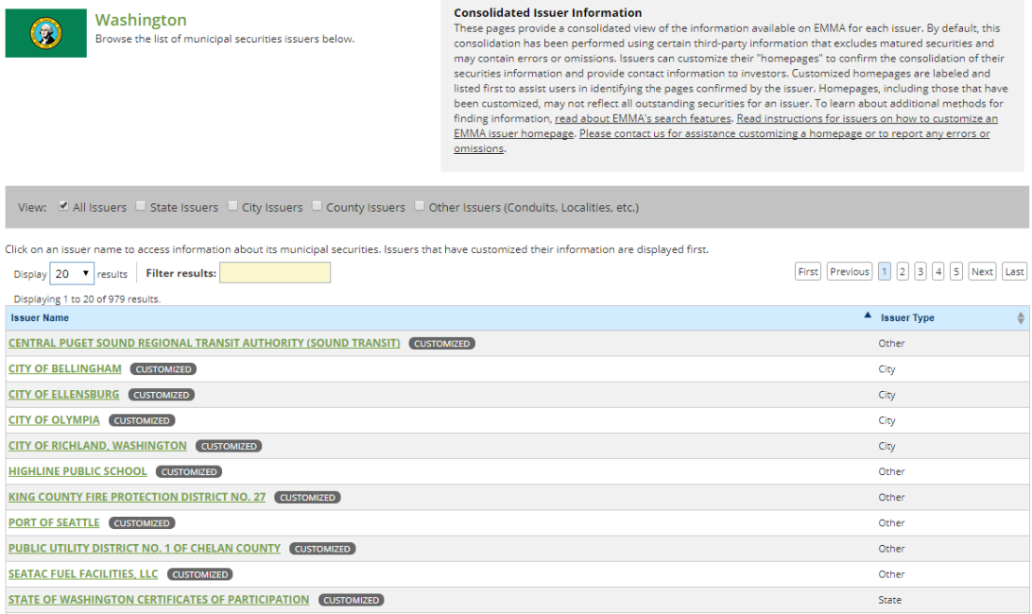
EMMA Issuer Homepages

Slide 41
Features of Issuer Homepages

Slide 42
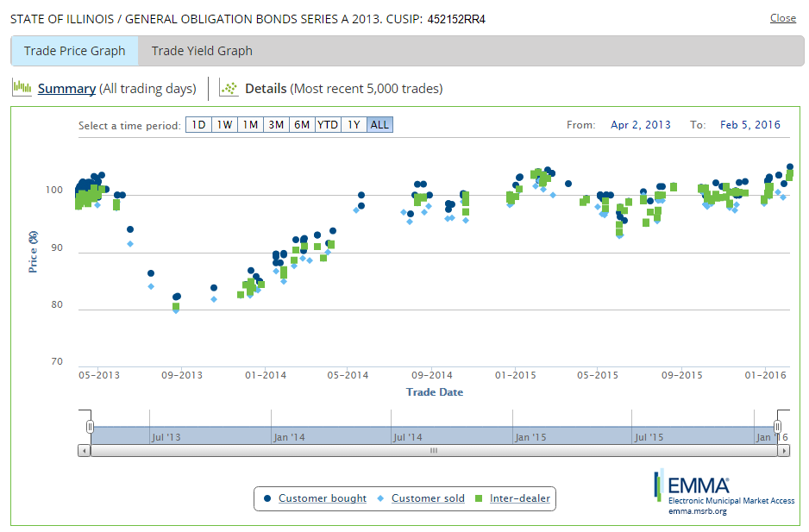
Real-Time and Historical Trade Data

Slide 43
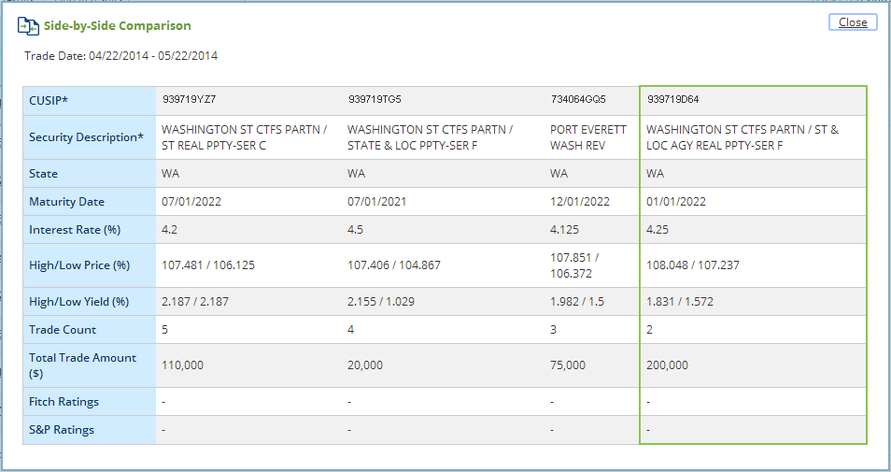
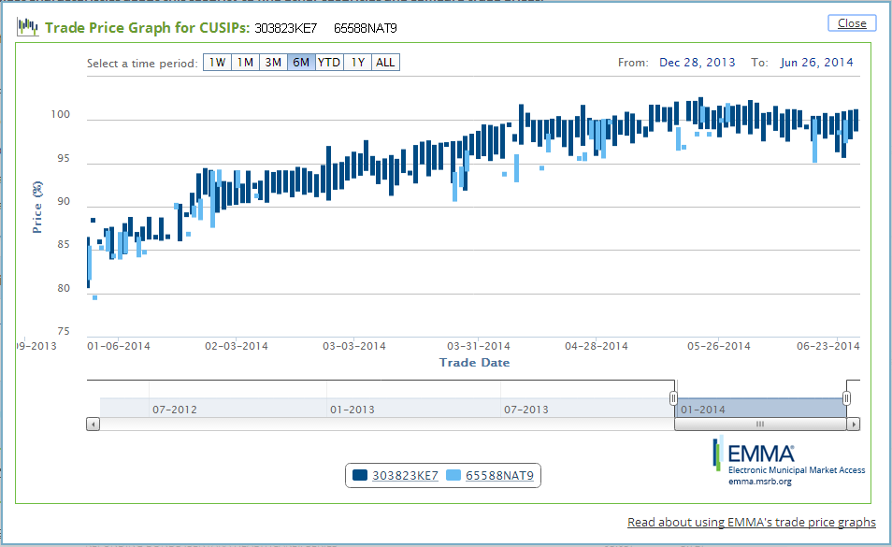
Price Discovery Tool

Slide 44
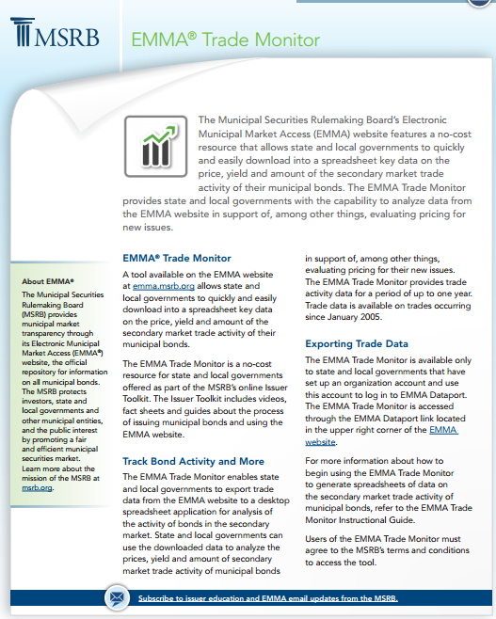
EMMA Trade Monitor
Export trade data from EMMA® to a desktop application
Analyze the prices, yield and amount of secondary market trade activity of municipal bonds
Support evaluation of pricing for new issues
Access with an organization account

Slide 45
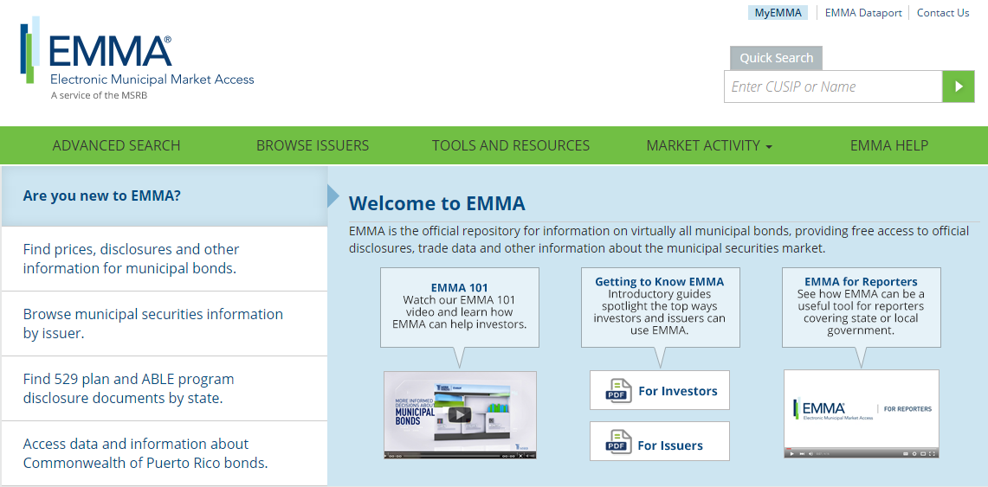
Tell Us What You Think
Share your ideas for ways to enhance EMMA®

Slide 46
Accessing Market Education

Slide 47
MSRB Education Center
Municipal Securities Rulemaking Board 47

Slide 48
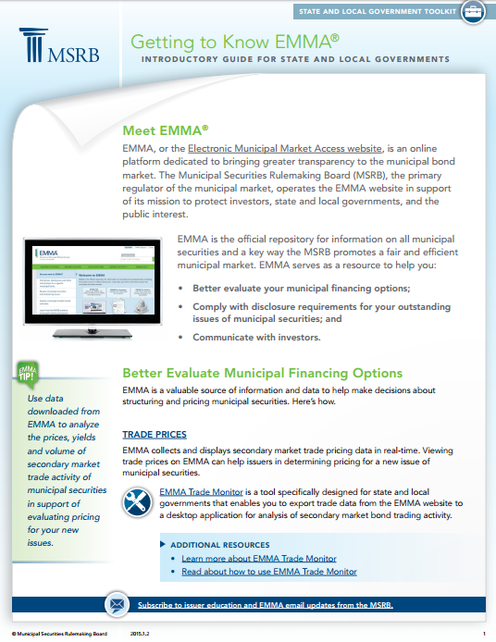
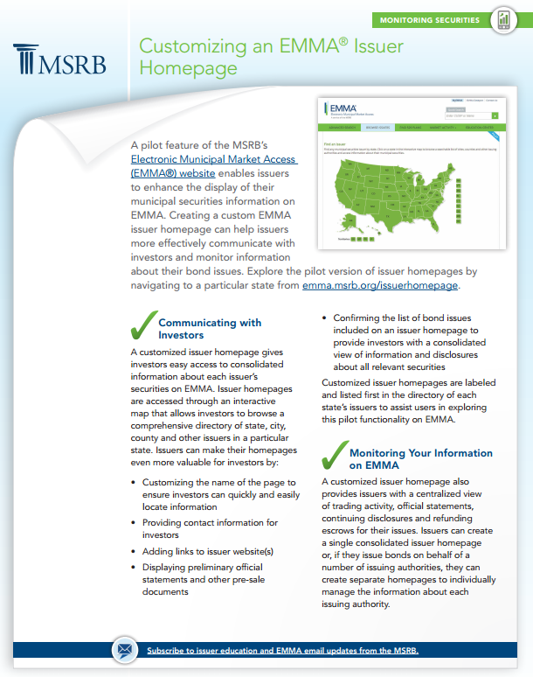
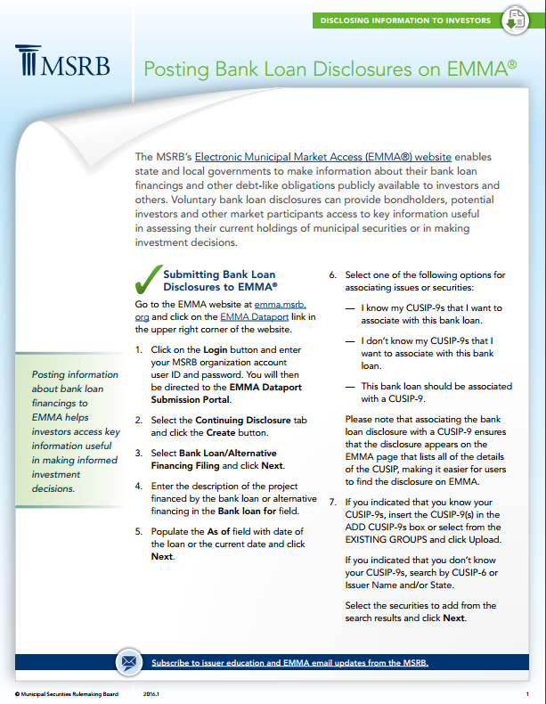
Free Educational Resources
Checklist for preparing to submit financial disclosures
Instructions for posting bank loan disclosures
Overview of roles of financing team
New resources added regularly

Slide 49
On-Demand Webinars
MSRB webinar portal available on MSRB.org
News and Events > Webinars
Register for upcoming live webinars on municipal market rules, new EMMA® features and other topics
Watch free on-demand webinars
Earn CPE credit

Slide 50
NEW MuniEdPro® Municipal Market Education
Free course for issuers
available at msrb.org
Interactive, online courses about municipal market activities and MSRB regulations

Slide 51
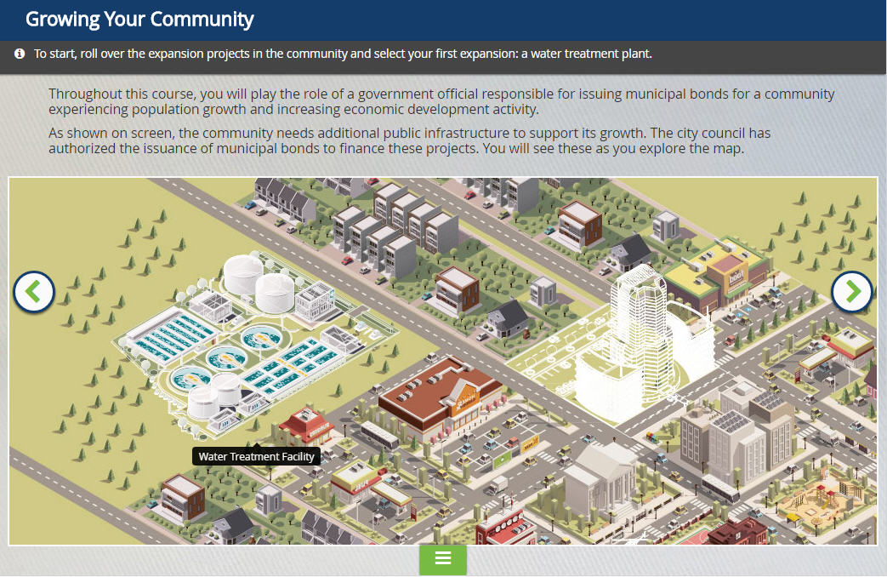
Complimentary Course: Being an Informed Municipal Bond Issuer
At the end of the course the learner will be able to:
Identify factors for selecting key professionals hired by a municipal bond issuer;
Describe key considerations when issuing municipal bonds; and
Understand an issuer’s obligations related to municipal bonds.
Log in at https://msrb.csod.com/client/msrb/default.aspx

Slide 52
MuniEdPro® Course Catalog
Current Offerings
Current Offerings
Exploring Municipal Bonds: A Course for Investors
Due Diligence: Primary Offering Disclosure Responsibilities
Complimentary Course: Being an Informed Municipal Bond Issuer
Role of the Regulator: Understanding the MSRB
The Decision to Borrow: Roles and Responsibilities of Market Participants in Fixed Rate Primary Market Offerings
Rules and Risks: Understanding MSRB Rules in Relation to Municipal Market Risks
Making Recommendations: Understanding Suitability and Time-of-Trade Disclosure for Municipal Securities Transactions
Standards of Conduct: The Duties of Non-Solicitor Municipal Advisors
Coming in 2017
Best Execution
Gifts and Solicitations
Mark-Ups and Disclosure
Find out more at MSRB.org

Slide 53
Contact the MSRB
Call MSRB Support
202-838-1330
MSRBsupport@msrb.org
Live support weekdays 7:30 a.m. - 6:30 p.m. ET
Questions about the municipal market?
MSRB.org | emma.msrb.org | @MSRB_News

