Slide 1
Photo by Social Fresh - Creative Commons Attribution-ShareAlike License https://www.flickr.com/photos/44278355@N06
Created with Haiku Deck

Slide 2
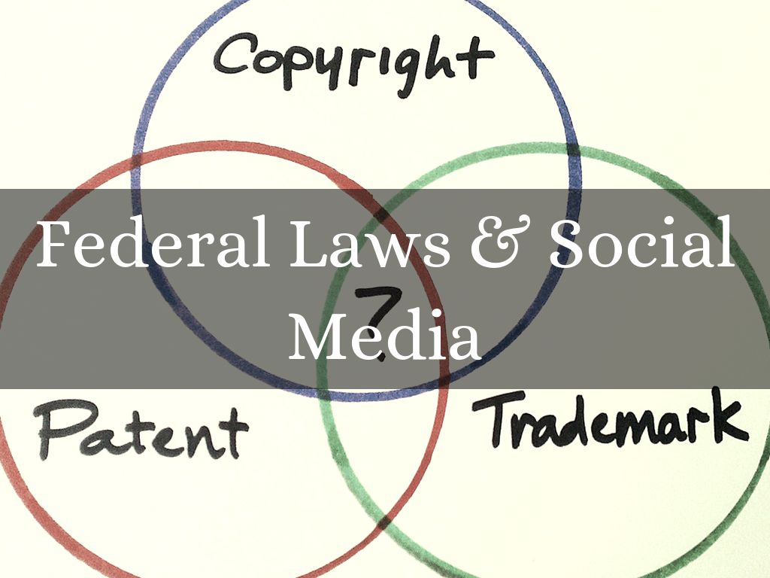
Photo by BusinessSarah - Creative Commons Attribution License https://www.flickr.com/photos/64160015@N05
Created with Haiku Deck

Slide 3
Photo by Horia Varlan - Creative Commons Attribution License https://www.flickr.com/photos/10361931@N06
Created with Haiku Deck

Slide 4
Photo by Horia Varlan - Creative Commons Attribution License https://www.flickr.com/photos/10361931@N06
Created with Haiku Deck

Slide 5
Photo by Horia Varlan - Creative Commons Attribution License https://www.flickr.com/photos/10361931@N06
Created with Haiku Deck

Slide 7
Photo by ntr23 - Creative Commons Attribution-NonCommercial-ShareAlike License https://www.flickr.com/photos/65919269@N00
Created with Haiku Deck

Slide 8
Photo by CarbonNYC [in SF!] - Creative Commons Attribution License https://www.flickr.com/photos/15923063@N00
Created with Haiku Deck

Slide 10
Photo by owenwbrown - Creative Commons Attribution License https://www.flickr.com/photos/42673922@N03
Created with Haiku Deck

Slide 11
Photo by mkhmarketing - Creative Commons Attribution License https://www.flickr.com/photos/93212162@N08
Created with Haiku Deck

Slide 12
Photo by StockMonkeys.com - Creative Commons Attribution License https://www.flickr.com/photos/86530412@N02
Created with Haiku Deck

Slide 15
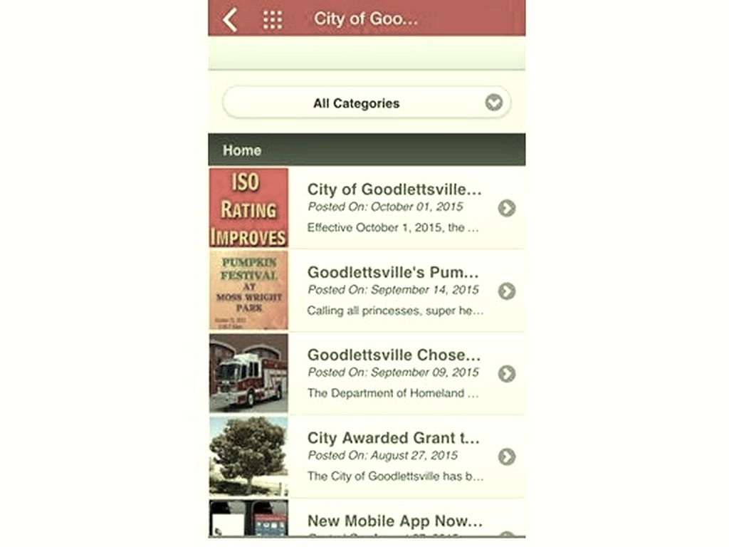

Slide 16
Photo by ecstaticist - Creative Commons Attribution-NonCommercial-ShareAlike License https://www.flickr.com/photos/41864721@N00
Created with Haiku Deck

Slide 17
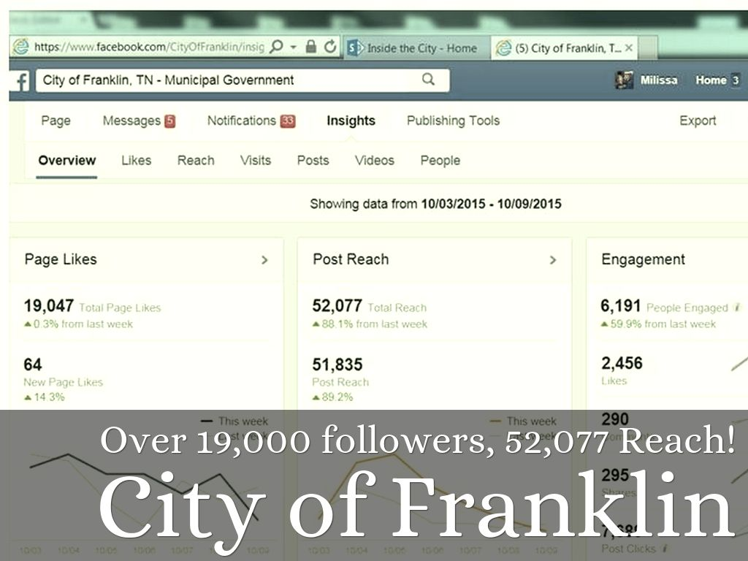

Slide 18
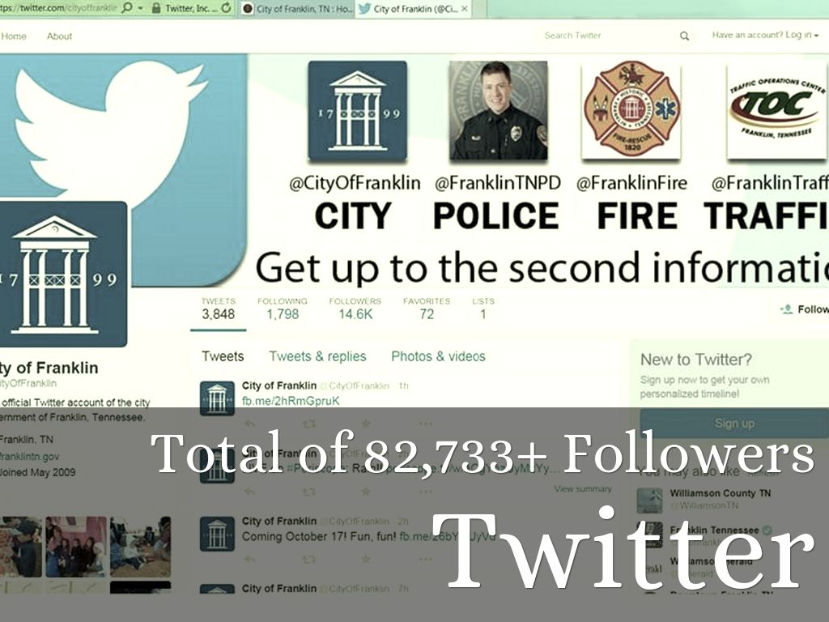

Slide 19
Photo by Nrbelex - Creative Commons Attribution-ShareAlike License https://www.flickr.com/photos/91351004@N00
Created with Haiku Deck

Slide 20
Photo by Amnesty International UK - Creative Commons Attribution License https://www.flickr.com/photos/7855337@N02
Created with Haiku Deck

Slide 21
Photo by Chris | christopherharrison.net - Creative Commons Attribution-NonCommercial-ShareAlike License https://www.flickr.com/photos/40573754@N04
Created with Haiku Deck

Slide 22
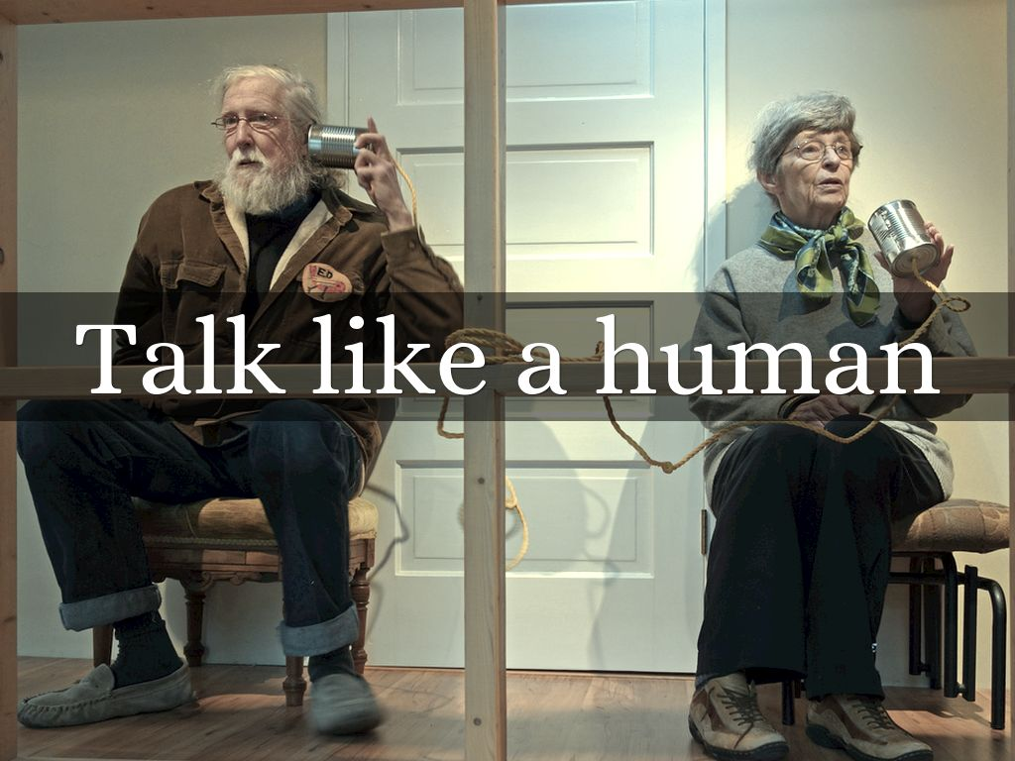
Photo by judy_and_ed - Creative Commons Attribution-NonCommercial License https://www.flickr.com/photos/65924740@N00
Created with Haiku Deck

Slide 23
Photo by AdamKR - Creative Commons Attribution-ShareAlike License https://www.flickr.com/photos/15593996@N08
Created with Haiku Deck

Slide 24
Photo by santiago nicolau - Creative Commons Attribution-ShareAlike License https://www.flickr.com/photos/23552357@N05
Created with Haiku Deck

Slide 25
Photo by clappstar - Creative Commons Attribution-NonCommercial License https://www.flickr.com/photos/70609370@N00
Created with Haiku Deck

Slide 26
Photo by Laenulfean - Creative Commons Attribution-ShareAlike License https://www.flickr.com/photos/60359963@N00
Created with Haiku Deck

Slide 27
Photo by Joaquin Villaverde Photography - Creative Commons Attribution-NonCommercial-ShareAlike License https://www.flickr.com/photos/46078235@N03
Created with Haiku Deck

Slide 28
Photo by Gunnar Wrobel - Creative Commons Attribution-ShareAlike License https://www.flickr.com/photos/36572163@N00
Created with Haiku Deck

Slide 29
Photo by aftab. - Creative Commons Attribution-NonCommercial License https://www.flickr.com/photos/72093892@N00
Created with Haiku Deck

