Slide 1
Tennessee State Board of Accountancy

Slide 2
State Specific Ethics for the Tennessee CPA
A Presentation to the Tennessee Government Finance Officers Assoc.
Wendy Garvin, Executive Director
Don Mills, CPA, CFE, CFF
TNSBA Investigator

Slide 3
The TNSBA consists of:
Eleven Members – CPA Members Appointed by Governor
Serve Terms of 3 Years
Nine are CPAs
One is Attorney
One is Public Member
Meets Quarterly- usually in January, May, July and October
Notes:
Wendy

Slide 4
Current Members of the Board
Pamela Church, CPA
Trey Watkins, CPA
Stephen Eldridge, CPA, Secretary
Janet Booker-Davis, CPA
Kevin Monroe, CPA
Gay Moon, CPA
Don Royston, CPA, Chair
Casey Stuart, CPA, Vice Chair
Larry Elmore, CPA
J. Gabe Roberts, Attorney-at-Law – Nashville, Attorney Member
Judy Wetherbee – Nashville, Public Member
Notes:
Wendy

Slide 5
Board Quiz:
All new Board members are selected by the Governor from a list of candidates provided by the TSCPA.
True
False
Notes:
False-The TSCPA does not provide candidates for the non-CPA board positions. Wendy

Slide 6

What’s New Under the TNSBA Sun?
Notes:
Wendy

Slide 7
New Additions:
CPA Licenses Awarded This Year: 320
New CPA Firms This Year: 41
Notes:
Wendy

Slide 8
Public Chapter 0595
Amends TCA Title 62, Chapter 1, relative to accountancy:
Deletes the language that the Executive Director shall be a certified public accountant with an active certificate in the state.
Amends 62-1-106(c) regarding the education requirements for a certificate and the requirements to sit for the examination.
Amends 62-1-201(b) to require all licensees subject to peer review to timely remit any peer review documents as specified by board rule or upon board request and that such documents be maintained by the board.
Notes:
Wendy

Slide 9
In other news:
From the Department of Labor:
Nearly 4 in 10 ERISA Audits Fail to Meet Professional Standards
DOL will make referrals to state boards and the AICPA Ethics Division
$653 Billion in Plan Assets & 22.5 Million Participants at Risk
Notes:
Wendy

Slide 10
CPAs in Tennessee
Notes:
Wendy

Slide 11


Requirements to Maintain a License
Status | Pay License Renewal Fee | Complete CPE | Professional Privilege Tax
Active
Inactive
Retired Over 65
Closed
Notes:
Wendy

Slide 12
License Status – Not So Good
Expired-Grace
Expired
Probation
Suspended
Revoked
Notes:
Expired-Grace is the new Delinquent Wendy

Slide 13
Continuing Professional Education
All Licensees Holding Active Licenses Must Have:
80 Approved Hours | add 8 penalty hours if you don’t
40 Technical Hours (A&A, Taxes, Ethics & Management Advisory) | add 8 penalty hours if you don’t
2 Hours State Specific Ethics | add 8 penalty hours if you don’t
Minimum of 20 Hours Each Year | add 8 penalty hours if you don’t
Notes:
8 penalty hours. Are we seeing a pattern here? Wendy

Slide 14
How do Carryover Hours Fit In?
Let’s take the mystery out of applying carryover CPE credits.
Notes:
Wendy

Slide 15
The Basics
You must have earned more than 80 hours during your previous two-year reporting period to qualify for carryover CPE credits. This doesn’t include credits carried forward from the last renewal.
Up to 24 hours can be carried forward, but they will not satisfy the technical or yearly minimums.
Carryover will never increase your total to more than 80 hours.
Once used, the carryover is gone—you cannot use carryover for the next renewal cycle.
Notes:
Wendy

Slide 16
So You Say You’ve Done Your CPE...
Each Spring, the Board chooses 10% of renewing licenses for AUDIT.
What happens if you are chosen?
Notes:
Wendy

Slide 17
CPE Audit
The Education Coordinator sends a letter of notification with a due date for submission
Followed up with emailed reminders
You’re required to submit a list of your credits, answer questions relevant to CPE requirements, and provide a certificate for each course
Submit by mail, email, or tn.cpetracker.com
You’ll receive a letter with the audit result
If penalty hours are added, you’ll have 180 days to comply
Notes:
Wendy

Slide 18
CPE Audit
Don’t be a complaint statistic!
You must respond to the audit, even if you didn’t
get all your CPE
Complaints are opened against licensees who
fail to respond or fail to complete penalty hours
in 180 days
Notes:
10 complaints so far this year Wendy

Slide 19
CPE For Reactivation
Reactivate:
You must have a viable license (Inactive or Closed)
Complete 80 hours of technical CPE within 24 months of application. This CPE counts toward your renewal hours.
Pay a $110 fee if license is closed
Notes:
Wendy

Slide 20
CPE For Reinstatement
Reinstate:
You do not have a viable license (Expired)
Request a Reinstatement application from Board staff.
Complete 80 hours of technical CPE within 6 months of your request for reinstatement. These are penalty hours and do not count toward renewal
Pay a $250 penalty.
Notes:
Wendy

Slide 21
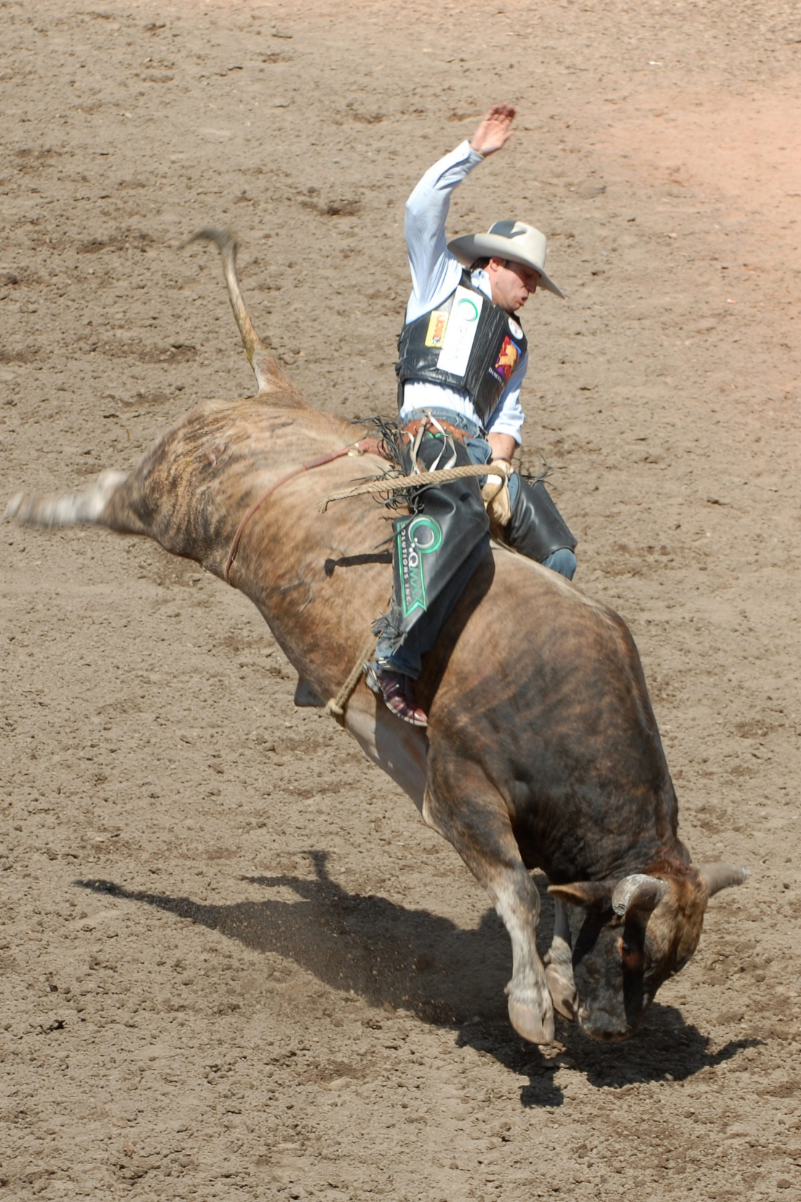
On the Horns of A Dilemma:
Case Studies in Ethics
Bull Rider “Texas Pete” Mills up on “Dilemma”
Notes:
We will look at two hypothetical case studies today that are based on real incidents with Tennessee licensees. Don

Slide 22
Ethical Dilemma #1
Business Valuation
Your client, ABC Pest Control, for whom you’ve prepared corporate tax returns only, has asked you to perform a business valuation for the purpose of a buy-sell insurance contract for the two stockholders. You have never formally performed a business valuation and possess no ABV or CVA designations.
Would you provide this service to your client?
Notes:
Don

Slide 23
Ethical Dilemma #1
General standards-perform only those services you are competent to complete.
Comply with all professional/technical standards which, in the case of business valuation, fall under the Statement on Standards for Consulting Services.
Falling short of the above standards can be construed as negligence.
Competency is of utmost importance in specialized engagements. Juries and judges have a high expectation of CPAs and an even higher expectation of specialists
Notes:
Don

Slide 24
Inactive Status Requirements
Very simple
Certificate holders in inactive status must place the word “inactive” adjacent to their CPA designation.
Notes:
Don

Slide 25
Inactive Status Requirements
Oh yes, one more thing:
If you are inactive, you may not perform accounting or auditing services for the public, including accounting services from a licensed accounting firm.
Rule 0020-05-.03(3)
Notes:
Accounting and Auditing services that issue a report. Don
Any consulting engagement that constitutes the attest function
Furnishing advice on tax matters

Slide 26
Inactive Status Requirements
Except (Wait for it):
  If the accounting services are provided without compensation to you;
  the services are performed solely for your employer and your employer is not a licensed accounting firm, or
  if you do not use the CPA designation in association with your name while providing such accounting services.
Notes:
Don

Slide 27
Inactive License Status Quiz:
My employer is not an accounting firm and the CEO requests that I give an opinion on the company’s financial statements even though I have an inactive license. Based on my extensive knowledge of the Law & Rules, can I do this?
Yes.
No.
Notes:
It does not matter what the slide says-you can’t do it because you are not independent. Don

Slide 28
I have a client who is leaving…
...and wants me to provide an electronic copy of his QuickBooks file to his new accountant. Can I send a paper copy instead?
Notes:
Don

Slide 29
Client Records
If the client has made satisfactory arrangements for payment for services rendered, you must provide a copy of the licensee’s working papers “to the extent that such working papers include records which would ordinarily constitute part of the client’s books and records and are not otherwise available to the client”.
Rule 0020-03-.11(1)(c).
The rule does not address the form in which these working papers must be provided.
Notes:
The AICPA states that the records should be provided in electronic format. Don

Slide 30

While we are on the subject of client records…
...I am selling my practice and moving to Panama City Beach.
Are there special rules regarding the transition?
Notes:
Don

Slide 31
Client Records as Personal Property
All statements, records, working papers, etc. generated in the course of providing accounting services cannot be sold, transferred or bequeathed without the consent of the client to anyone except:
One or more surviving partners or;
New partners, shareholders, etc. or;
Any combined or merged firm or successor in interest to the licensee.
TCA 62-1-115
Notes:
Don

Slide 32
Peer Review Requirements
  Tennessee requires peer review for any firm that performs the attest function.
Notes:
Wendy

Slide 33
And “attest” is defined as…
Tennessee Code Annotated, Section 62-1-103, states that attest means providing the following services:
Any audit or other engagement performed in accordance with the Statements on Auditing Standards (SAS)
Any review performed in accordance with the Statements on Standards for Accounting and Review Services (SSARS)
Any examination performed in accordance with the Statements on Standards for Attestation Engagements (SSAE)
The issuance of any report, including compilation reports, prescribed by the SASs, the SSARSs, or the SSAEs on any services
Notes:
If you are dropped (or resign) from the Peer Review Program, the TSCPA notifies the Board. Wendy

Slide 34
Attest Engagements in the SSAEs
Engagements (with certain exceptions) in which a certified public accountant is engaged to issue a report on subject matter that is the responsibility of another party.
Agreed-Upon Procedures
Financial Forecasts and Projections
Reporting on Pro Forma Financial Information
Compliance Attestation
Management’s Discussion & Analysis
Notes:
Wendy

Slide 35
Whoa! What Are The Exceptions?
  If you are providing the following services, you are not subject to peer review:
  Engagements where the CPA acts in support of a client’s position- such as tax matters being reviewed by the IRS.
  Engagements to prepare tax returns or provide tax advice.
  Services performed in accordance with the Statement on Standards for Consulting Services (SSCS)
Notes:
Wendy

Slide 36
Consulting v. Attestation
In an attest service, you are engaged to express an opinion regarding an assertion that is the responsibility of another party,
In a consulting service, you are engaged for the benefit of the client. The nature and scope is determined by the agreement between you and the client.
    Forensic Examination
    Expert Witness Services
    Valuation Services
    Divorce Engagements
Notes:
You are engaged to assist the client- preparing information other than financial statements. Wendy

Slide 37
Quiz Time
Q: What's the difference between death and taxes?
A: Congress doesn't meet every year to make death worse.
Notes:
Don

Slide 38
Firm Names- Ya Gotta Love ‘em
Notes:
Wendy

Slide 39
Firm Names Quiz:
As a member of the Board, you receive a request for a firm permit from the person in the previous slide.
Your decision is:
Approve the application because the name is not misleading.
Deny the application because the name is misleading.
Approve the application because there is no accounting for taste.
Deny the application because it does not contain the actual name of the CPA.
Notes:
Wendy

Slide 40
Compilation or Preparation:
 | Compilation (Section 80 of SSARS No. 21) | Preparation (Section 70 of SSARS No. 21)
When does the standard apply? | When the accountant is engaged to perform a compilation | When an accountant is engaged to prepare financial statements
Is an engagement letter required | Yes | Yes
Is the accountant required to determine if he or she is independent of the client? | Yes | No
If the accountant is not independent, is that fact required to be disclosed in the accountant’s report? | Yes | N/A
Does the engagement require a report? | Yes | No*
May the financial statements go to users outside of management? | Yes | Yes
May the financial statements omit notes? | Yes | Yes
Notes:
Wendy

Slide 41
Compilation or Preparation:
*When an accountant is engaged to prepare financial statements, the accountant is required to include an adequate statement on each page of the financial statements indicating that no CPA provides any assurance on the financial statements. If the accountant is unable to include an adequate statement on each page of the financial statements, the accountant is required to issue a disclaimer on the financial statements.
Notes:
Wendy

Slide 42
Ethical Dilemma #2
Conflict of interest—divorce.
Your longtime clients Joe Bob and Lee Ann are entering into divorce proceedings, and Joe Bob, whom you’ve never met (because Lee Ann handles all the financial affairs of the couple, including taxes) has requested that you provide tax services to him as well as to Lee Ann during and after the divorce process.
How would you handle this request?
Notes:
Don

Slide 43
Ethical Dilemma #2
If your clients are in dispute with each other, you may be brought into the dispute via conflict-of-interest charges.
Marriages require the CPA to treat each partner equally, regardless of who owns more assets or who pays the fees.
Although representing both spouses is not prohibited, it’s not really a good idea.
However, the engagement can work. Start by having both spouses sign consent forms waiving any potential conflict of interest.
Notes:
Don

Slide 44
State Specific Ethics-
Has this course had an effect on complaints?
Notes:
Wendy

Slide 45
Complaint Category | Total
Unlicensed Activity | 33
PPT | 22
Fraud/Gross Negligence | 16
Due Professional Care | 14
CPE Audit | 9
Peer Review | 7
Discreditable Acts | 7
Other State Action | 4
Ethics | 2
CPE Requirements | 3
Felony | 1
Federal Violation | 1
Notes:
Unlicensed Activity is typically number 1 Wendy

Slide 46

Pursuit of the Unlicensed:
Don Mills, Investigator
Glamorous as well as exciting
Notes:
Wendy

Slide 47
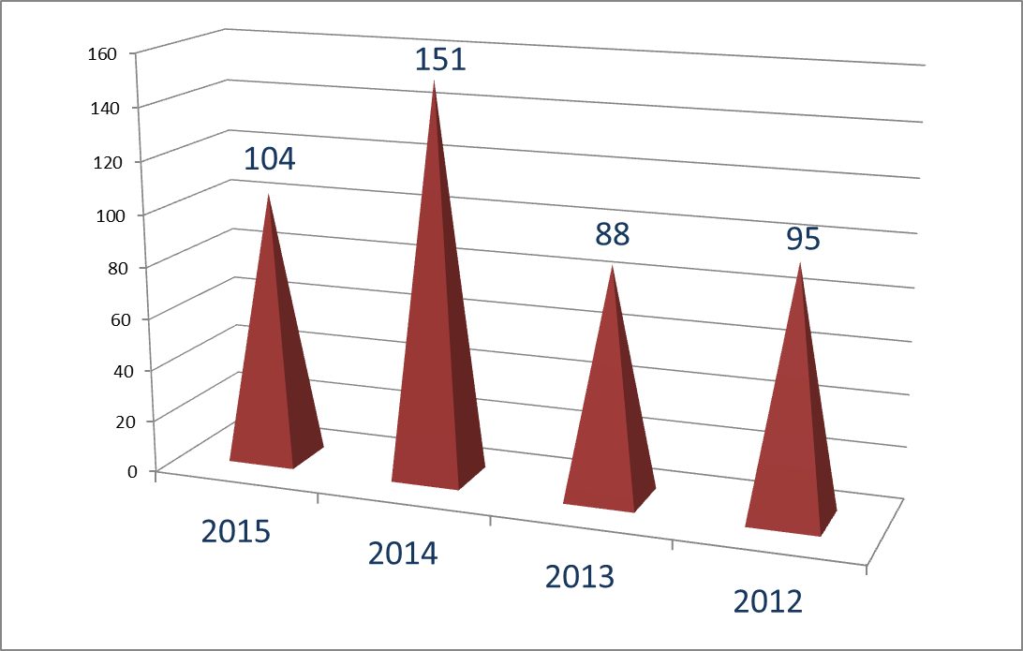
Complaint History
Notes:
Historically, the Board opens an average of 109 complaints each year. 43 complaints opened so far in 2016. Wendy

Slide 48
Possible Board Actions
Dismissal
Letters
Consent Orders
  Civil Penalties
  Additional CPE or Peer Review
  Probation
  Suspension
  Revocation
Informal Conference
Formal Conference (Hearing)
Notes:
Wendy

Slide 49
Civil Penalty Quiz:
As a member of the Board, you determine the amount of civil penalty based on which of the following criteria:
Whether the amount will be a substantial economic deterrent to the Respondent.
The circumstances leading to the violation.
The economic benefits gained by the Respondent as a result of non-compliance.
The severity of the violation and the risk of harm to the public.
The fact that you never liked the Respondent anyway.
Notes:
#1 through #4 are correct Wendy

Slide 50
FY16 Board Actions
Notes:
Wendy

Slide 51
I know you all love case studies, so we are going to talk about one or two, but you have to decide if the punishment fits the violation.
Notes:
Don

Slide 52

THE COMPLAINT
The Complaint alleges that the Respondent CPA embezzled in excess of $200,000 while he was employed as the CFO of a Tennessee corporation. He was terminated after the embezzlement was discovered.
Notes:
Don

Slide 53
THE DOCUMENTATION
The corporation’s insurance carrier made a payment $217,601.47 after an evaluation by a forensic accounting firm noted the following:
The corporation’s credit cards showed charges were made for personal travel, auto expenses, cell phones, general purchases and purchases related to the Respondent’s new accounting practice. The losses in this category were $121,226.81.
The Respondent converted his term life insurance to a deferred annuity which was paid for by the corporation. The loss agreed to was $80,729.
The Respondent purchased computers and related software for his new accounting practice via corporate checks. The loss $23,458.89.
Notes:
Travel to Disney ($2,743), Daytona Beach, Niagara Falls, the Caymans and Montana Don

Slide 54
THE RESPONSE
The Licensee asserts that he was a stockholder in the corporation and the expenditures were part of his compensation package. (there were no corporate minutes to support this assertion)
He asserts that any purchases made for his personal use were booked to an employee receivable account and were added to his W-2 at year end. (this assertion is partially correct; but failed to mention that he wrote off the receivable via journal entry at year end)
Faced with civil suits and possible revocation of his license, he closed his practice and moved to another state.
Notes:
Don

Slide 55
DISPOSITION
  You are the Board – What action should be taken?
    Dismiss- He is out of the Board’s jurisdiction.
    Letter of warning for making unauthorized journal entries.
    Consent Order with restitution paid to former employer and a license suspension of five years.
    Revocation of his license; Civil penalty of $5,000 and notice of the revocation to the state in which he is now practicing, the IRS, AICPA, TSCPA and his mother.
    Other?
Notes:
Don

Slide 56

THE COMPLAINT
A Complainant made the following allegations:
Her CPA deposited the Complainant’s Federal income tax refunds directly into the CPA’s bank account without her knowledge in:
  2011- $6,019
  2012- $5,091
  2013- $4,242
Her CPA convinced her that she owed $13,000 to IRS on the sale of her dead husband’s dump truck and asked for two checks which would be sent to the IRS.
Before his death, the Complainant’s husband wrote checks totaling over $28,000 for “estimated taxes” to the CPA between 2011 and 2013.
Notes:
Don

Slide 57
THE RESPONSE
The CPA’s Response was:
The Complainant’s husband borrowed money from the CPA and told her to keep the refunds as partial payment. There was a promissory note, but it had been given to the Complainant and no copy existed.
The husband prepared and e-filed his own returns on the CPA’s computer. This allowed the CPA to have the refunds deposited into her bank account (especially useful after his death in August of 2013).
The checks (28K) with “taxes” written on the memo line were repayments of money borrowed by the husband. No estimated taxes were ever paid by the CPA on behalf of her client.
The $13,000 “Truck Tax” was actually the balance due from the deceased husband.
Notes:
Don

Slide 58
THE INVESTIGATON
As the investigation unfolded, some aspects of the Respondent’s story changed:
Well, yes, it appears that the dead husband did not file his 2013 tax return. The Respondent “accidentally” e-filed a draft return and the refund was deposited to her bank account on February 18, 2014.
When she discovered the mistake, she immediately sent the Complainant a check - on December 1, 2014.
She also discovered a copy of the promissory note-but it was unsigned.
Notes:
Her discovery of the refund coincided perfectly with the Complainant’s filing with the IRS Don

Slide 59
FINAL ANSWER
The answers are now coming from the Respondent’s Attorney:
No Form 8829s are available in the Respondent’s records.
No business records of the client were retained.
A new draft of the 2013 tax return has been presented to the Complainant, and it includes (surprise, surprise) taxable gains from the sale of the dump truck.
But she did produce a copy of a signed and witnessed promissory note from the Complainant’s dead husband.
Notes:
Don

Slide 60
DISPOSITION
  You are the Board – What action should be taken?
    Dismiss- The Complainant should have known that her husband was a gamblin’ man.
    Letter of Warning- The IRS may find some of your e-filings questionable.
    Consent Order- requiring a CPE course on determination of the basis of inherited assets.
    Revocation of the CPA’s license until the end of time.
Notes:
Don

Slide 61
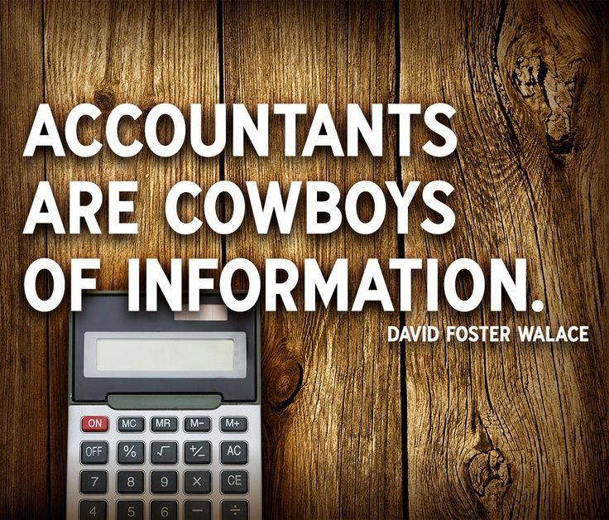
The Last Word
Notes:
Found in the Novelist’s notes while taking a tax class in preparation for writing “The Pale King”.

Slide 62
We would like to thank TNSBA Board Staff Member Karen Condon- without her talent and imagination, the entire presentation would look like this.
Notes:
Don

Slide 63
Thank You For Listening
Contact Information
  Phone: 888-453-6150 or 615-741-2550
  Fax: 615-532-8800
  Web: tn.gov/regboards/tnsba
  E-Mail: Accountancy.Board@TN.Gov

