Slide 1
2017 Economic Outlook: Global, National & State Perspectives
Matthew N. Murray, Associate Director

Slide 2
GDP Grows, But Slower than Typical Expansions
Notes:
08/22/16; GDPR; % chg Annual Rate; includes BEA revisions beginning 2011q1 forward
FRED series: GDPC1
Seasonally Adjusted Annual Rate Frequency: Quarterly Units: Percent Change from Preceding Period
DO NOT USE 3-QTR SMOOTHING FOR GDP!!!!!!!
Real Chained 2009 dollars
Growth is calculated using SAAR. (((B/A)^4)-1)*100 – 3 quarter moving average
FRED GDPC1
(SAAR Compounded annual rate)

Slide 3
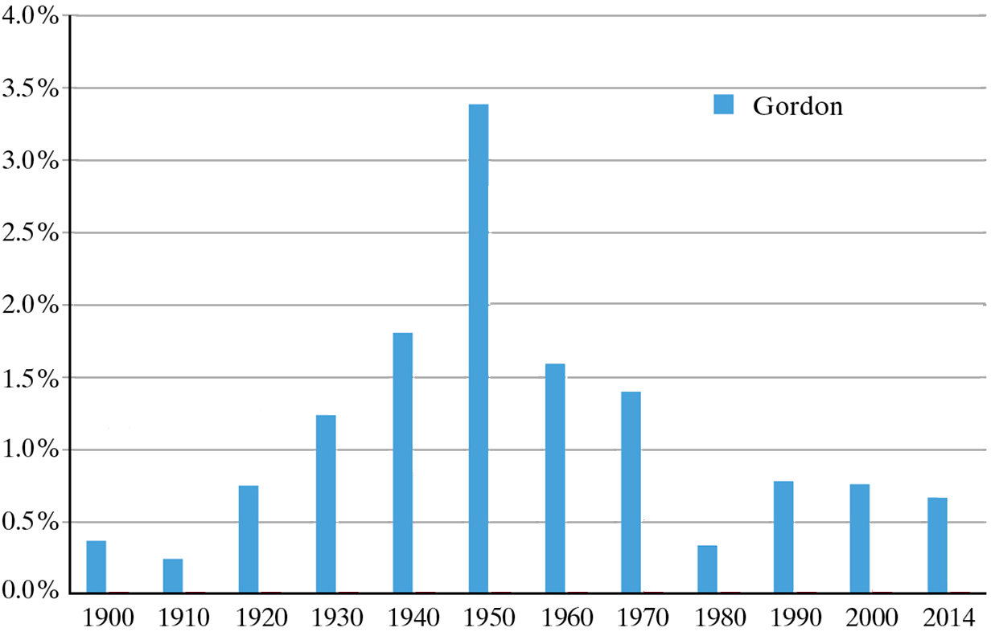
Productivity Growth Has Been Sluggish for Four Decades
Average Annual Growth Rates
Gordon, Robert J. The Rise and Fall of American Growth: The U.S. Standard of Living Since the Civil War.
Decade Ending in Year

Slide 4
Gasoline Prices Near Recession Lows
Aug-16 is month-to-date
Notes:
8/23/2016;
http://www.eia.gov/petroleum/gasdiesel/ Data 3: Regular All Areas All Formulations
FRED series: GASREGW

Slide 5
Light Vehicles Sales Near Historical High
Notes:
8/22/16; SUVLV; level; FRED series: ALTSALES

Slide 6
Household Formation Slowing Among the Young

Slide 7
Housing Sales Rising but Remain Low for an Expansion
Notes:
8/22/2016; HUESOLD, HUSPS; levels; AUG16 IHS short-term forecast bank
EXHOSLUSA495S
HOUST Fred
Global Insight Baseline for current year

Slide 8
Housing Sales Also Rising in Tennessee
Notes:
8/23/2016

Slide 9
Business Investment is a Drag on the Economy
Notes:
8/22/2016; this is not REAL dollars; series from FRED is nominal, SAAR
W987RC1Q027SBEA from FRED
3-quarter moving average

Slide 10
Federal Deficits are a Low Share of GDP, but …
Notes:
8/22/2016; netsavgfunify; AUG16 IHS, Inc.
FRED series FYFSD (not unified-budget basis)
FYFSD

Slide 11
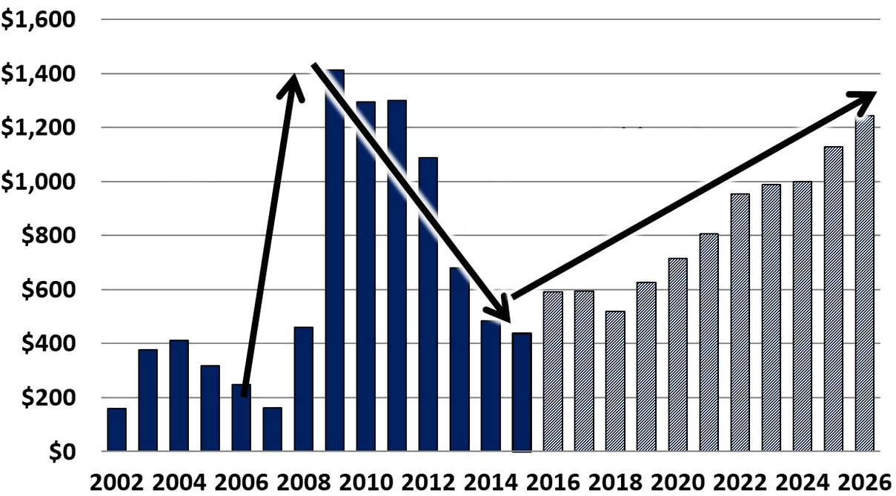
Deficits Rise Rapidly in the Future (billions)

Slide 12
Aging Society and Interest Costs Raise Federal Spending from 21% to 28% of GDP in 2046
Source: Congressional Budget Office, The 2016 Long-Term Budget Outlook, July 12, 2016, Figure 1.4.

Slide 13
Interest Rates and Inflation Rates Low, but Inching Upward
Notes:
8/22/2016 RMFF & CPI (yr-over-year % change)

Slide 14
Nonfarm Job Growth Will Continue While Manufacturing Jobs Will Revert to Contraction
Source: Bureau of Labor Statistics; IHS, Inc.; and UT-BCBER.
Notes:
U.S: 8/19/2016 USJUL16 GI forecast
TN: actuals 2000-2015 from BLS (May 12, 2016) with ERG2016 forecast (workfile as of Jan 21 from LK)

Slide 15
Full Recovery from the Great Recession in Most Sectors
(July 2016 Employment as a Share of December 2007 Employment)
Source: Bureau of Labor Statistics.
Notes:
08/19/2016; current to recession peak

Slide 16
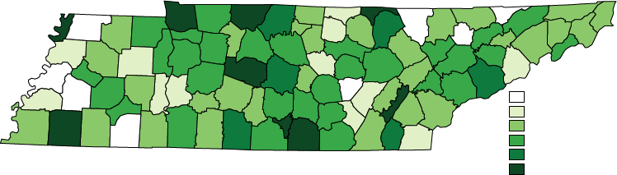
Dramatic Differences in Post-Recession Private Employment Growth Across Tennessee (2007 to 2015)
Tennessee: 3.4%
U.S.: 3.8%
-44.3% to -20.0%
-19.9% to -10.0%
-9.9% to 0.0%
0.1% to 9.9%
10.0% to 19.9%
20.0% or higher
Note: Employment covered by the state unemployment insurance program.
Source: Bureau of Labor Statistics.
Notes:
08/19/2016; (different from VolState; 2015 is now final)

Slide 17
Tennessee Enjoys Broad-Based Job Gains
(July 2015 to July 2016)
Source: Bureau of Labor Statistics.
September 2016
17
Notes:
08/19/2016

Slide 18
MSA Employment Growth – Positive but Mixed
(Quarter Ending July 2015 to July 2016 )
Source: Bureau of Labor Statistics.
September 2016
18
Notes:
08/19/2016; current to recession peak
FRED series: TNNA CHAT847NA CLEV447NA CLHNA JACNA JOHN747NA KING747NA KNOX947NA MORR147NA MPHNA NASH947NA

Slide 19
Metro Areas See Strongest Employment Growth
(1990 to 2016*)
19
Notes:
8/19/2016; S:\CONTRACT\CUNNINGHAM\PPT CHARTS\CNTY MSA LABOR FORCE.xlsx

Slide 20
Tennessee’s Unemployment Now Rests Below the National Rate
Source: Bureau of Labor Statistics; IHS. Inc.; UT-BCBER.
September 2016
20
Notes:
8/22/16
USAUG16 IHS forecast TN from SPR16 QTEM

Slide 21
Rural Counties in Tennessee Experience Highest Unemployment Rates (July 2016)
Tennessee: 4.9% (4.3% SA)
U.S.: 5.1% (4.9% SA)
3.8% to 4.9%
5.0% to 5.9%
6.0% to 6.9%
7.0% to 8.8%
Note: Data are not seasonally adjusted.
Source: Bureau of Labor Statistics.
September 2016
21
Notes:
8/31/2016

Slide 22
Don’t Blame the Great Recession--U.S. Labor Force Participation Rate Peaked in 2000
Source: Bureau of Labor Statistics.
September 2016
22
Notes:
8/19/16 BLS: LNS11300000 (total), LNS11300001 (men), LNS11300002 (women)

Slide 23
Labor Force Participation Rates Points to Short-Term Turnaround
Source: Bureau of Labor Statistics.
23

Slide 24
Tennesseans Have Poor Health Status Which Affects Labor Force Outcomes
Disability rates are up for both the U.S. & TN, but rate in TN is 34% higher than the national rate
Source: Centers for Disease Control and Prevention, Behavior Risk Factor Surveillance System.
24
Notes:
2014 http://nccd.cdc.gov/BRFSSPrevalence/rdPage.aspx?rdReport=DPH_BRFSS.ExploreByTopic&islClass=CLASS03&islTopic=Topic10&islYear=2014&go=GO

Slide 25
Trailing Levels of Educational Attainment Contribute to Trailing Levels of Income and Lower Participation Rates
Percentage of population aged 25 Yrs & Older
Percentage of population aged 25 Yrs & Older
Source: U.S. Census Bureau.
September 2016
Notes:
American Factfinder ACS Table S1501 (various years, all 5-year averages); 05/16/16

Slide 26
Per Capita Personal Income in Tennessee Falls Below the National and Regional Averages
Source: Bureau of Economic Analysis.
September 2016
26
Notes:
downloaded from BEA 05/13/16

Slide 27
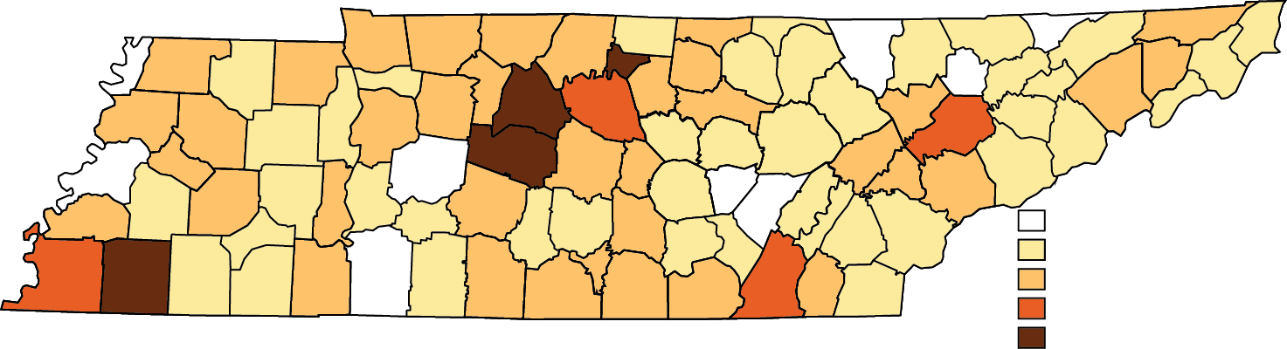
Per Capita Income is Lower than the U.S.
Average in All But Four TN Counties
Less than $27,000
$27,000 to $33,250
$33,500 to $40,450
$40,451 to $46,048
Greater than $46,048
Source: Bureau of Economic Analysis.
September 2016
27
Notes:
01/21/16; current dollars. !! entire county personal income series revised back to 1969 !!
2014 is most recent county-level per capita personal income data (checked BEA 08/19/2016)

Slide 28
Tennessee Tax Revenues Rise but Burden Falls
Tax Revenues (in millions)
28
Notes:
*Total includes earmarked;
updated 8/23/16 using data from TAXCOLL.xlsx dated 15Aug2016
FY2015 Total Tax from FY2017 Budget document; quarterly PI from BEA and BCBER qtem forecast converted to fiscal years

Slide 29
Sales Tax Collections Show Strong Growth
(Quarter Ending July 2015 to July 2016)
September 2016
29
Notes:
8/19/2016; 3-mon moving average ending JULY

Slide 30
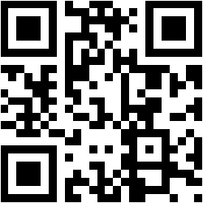
Boyd Center for Business & Economic Research
Haslam College of Business
The University of Tennessee, Knoxville
716 Stokely Management Center
916 Volunteer Boulevard
Knoxville, Tennessee 37996-0570 phone: 865.974.5441 fax: 865.974.3100
http://cber.haslam.utk.edu

