Slide 1
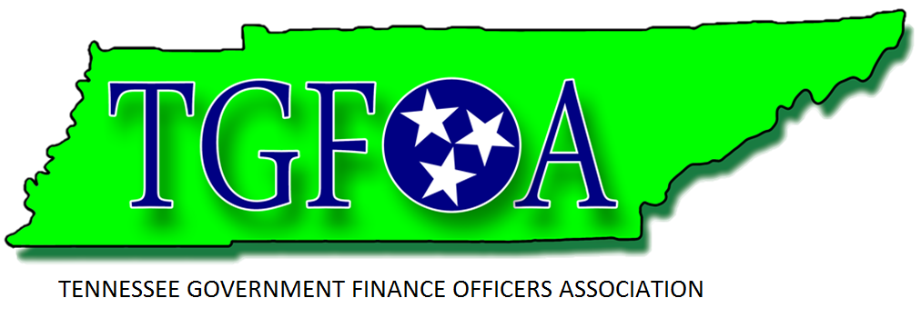
Open Data: The Future of Government Transparency Presenters: Michael Walters Young, Franklin Randall P. Williams, Metro Nashville
TGFOA Spring Institute – Memphis March 17, 2016

Slide 2
Outline - Explanation of Open Data - Why it is important - The Tennessee Context - Nashville - Chattanooga - Franklin - What you can do about it
Open Data: The Future of Government Transparency
TGFOA Spring Institute – Memphis March 17, 2016

Slide 3
Open Data: What is it? Succinctly, Open Data is the idea that data should be accessible and available for anyone to use at anytime. What does it mean in government? That the data we collect, house and use also should be open and available – to internal and external users – at anytime.
Open Data: The Future of Government Transparency
TGFOA Spring Institute – Memphis March 17, 2016

Slide 4
Open Data: Why is it important? Think about the last definition – is your data available and accessible to internal and external users at anytime? Is it even available to your internal users? And even then all internal users? Do you know what data you have and do not have?
Open Data: The Future of Government Transparency
TGFOA Spring Institute – Memphis March 17, 2016

Slide 5
Open Data: Why is it important? - Data is the currency of our age. And it is ever expanding. Consider for a moment: The world had about 800,000 petabytes of data in 2009. The amount of data are doubling every two years. – What’s next: • Exabyte = 1,048,576 terabytes • Zettabyte = 1,073,741,824 terabytes • Yottabyte = 1,099,511,627,776 terabytes Sources: Zdnet (2010). Size of the data universe: 1.2 zettabytes and growing fast. http://www.zdnet.com/ article/size‐of‐the‐data‐universe‐1‐2‐zettabytes‐and‐growing‐fast/ Adshead, A. (2012). Data to grow more quickly says IDC’s Digital Universe Study. http://www.computerweekly.com/news/2240174381/Data‐to‐grow‐more‐quickly ‐says‐IDCs‐Digital‐Universe‐study
Open Data: The Future of Government Transparency
TGFOA Spring Institute – Memphis March 17, 2016

Slide 6
Open Data: What does this really have to do with government? Governments are some of the biggest producers of data. And the private sector is already revolutionizing how they provide what they provide by having data analytics – not just how many widgets they make or services they provide, but tracking who, what, where, when and how they provide them.
Open Data: The Future of Government Transparency
TGFOA Spring Institute – Memphis March 17, 2016

Slide 7
Open Data: What does this really have to do with government? Think about Amazon, or even the USPS. You can see where your package is at any given time. Same with Pizza (or Central BBQ). Or where a plane is in mid-air. Data and the application of data is everywhere. And our citizens have come to expect easy access to data – all data.
Open Data: The Future of Government Transparency
TGFOA Spring Institute – Memphis March 17, 2016

Slide 8
Open Data: The Tennessee Context Three cities have partnered with a private vendor – Socrata – in their efforts to open data up to their citizens: Metropolitan City of City of Government of Chattanooga Franklin Nashville & Davidson County
Open Data: The Future of Government Transparency
TGFOA Spring Institute – Memphis March 17, 2016

Slide 9
Open Data: The Tennessee Context Metropolitan Government of Nashville & Davidson County
Open Data: The Future of Government Transparency
TGFOA Spring Institute – Memphis March 17, 2016

Slide 10
Open Data: The Tennessee Context City of Chattanooga data.chattanooga.gov
Open Data: The Future of Government Transparency
TGFOA Spring Institute – Memphis March 17, 2016

Slide 11
Open Data: The Tennessee Context City of Franklin FranklinForward The City’s Strategic Plan
Open Data: The Future of Government Transparency
TGFOA Spring Institute – Memphis March 17, 2016

Slide 12
Open Data: What can you do about it? 1) Form a Data Team 2) Determine what data you actually possess 3) Evaluate your comfort with Open Data 4) Determine why you would make data open
Open Data: The Future of Government Transparency
TGFOA Spring Institute – Memphis March 17, 2016

Slide 13
Open Data: What can you do about it? 5) Assess Options for Data Access Options: Internal or External Internal: Microsoft Sharepoint, Google Apps External:
Open Data: The Future of Government Transparency
TGFOA Spring Institute – Memphis March 17, 2016

Slide 14
Summary - Open Data is here. You have to be prepared for it. - Unparalleled opportunity to make our democracies more democratic. - As with any service delivery, managing expectations is the key to success. - Evaluate what you have. - Determine your comfort level. - Ask your friendly peers.
Open Data: The Future of Government Transparency
TGFOA Spring Institute – Memphis March 17, 2016

Slide 15
Resources: Websites: U.S. Government: www.data.gov Nashville: https://data.nashville.gov/ Chattanooga: https://performance.chattanooga.gov/ Franklin: https://performance.franklintn.gov/ ICMA Insights: http://icma.org/en/results/center_for_performance_measurement/icma_insights Socrata: www.socrata.com OpenGov: www.opengov.com DKAN (GovDelivery) Open Source solution: http://www.nucivic.com/dkan/ GFOA: www.gfoa.org
Open Data: The Future of Government Transparency
TGFOA Spring Institute – Memphis March 17, 2016

Slide 16
Resources: People: Randall P. Williams Division Manager – Web Based Services Metropolitan Government of Nashville and Davidson County Phone: 615.862.6113 – E-Mail: Randall.Williams@Nashville.gov Tim Moreland Director of Performance Management and Open Data City of Chattanooga Phone: 423.643.7827 - E-Mail: tmoreland@chattanooga.gov Michael Walters Young Budget & Analytics Manager City of Franklin Phone: 615.550.6687 – E-Mail: michael.waltersyoung@franklintn.gov
Open Data: The Future of Government Transparency
TGFOA Spring Institute – Memphis March 17, 2016

Slide 17
Happy St. Patrick’s Day! & Let’s watch March Madness!
Open Data: The Future of Government Transparency
TGFOA Spring Institute – Memphis March 17, 2016

